Slide 1
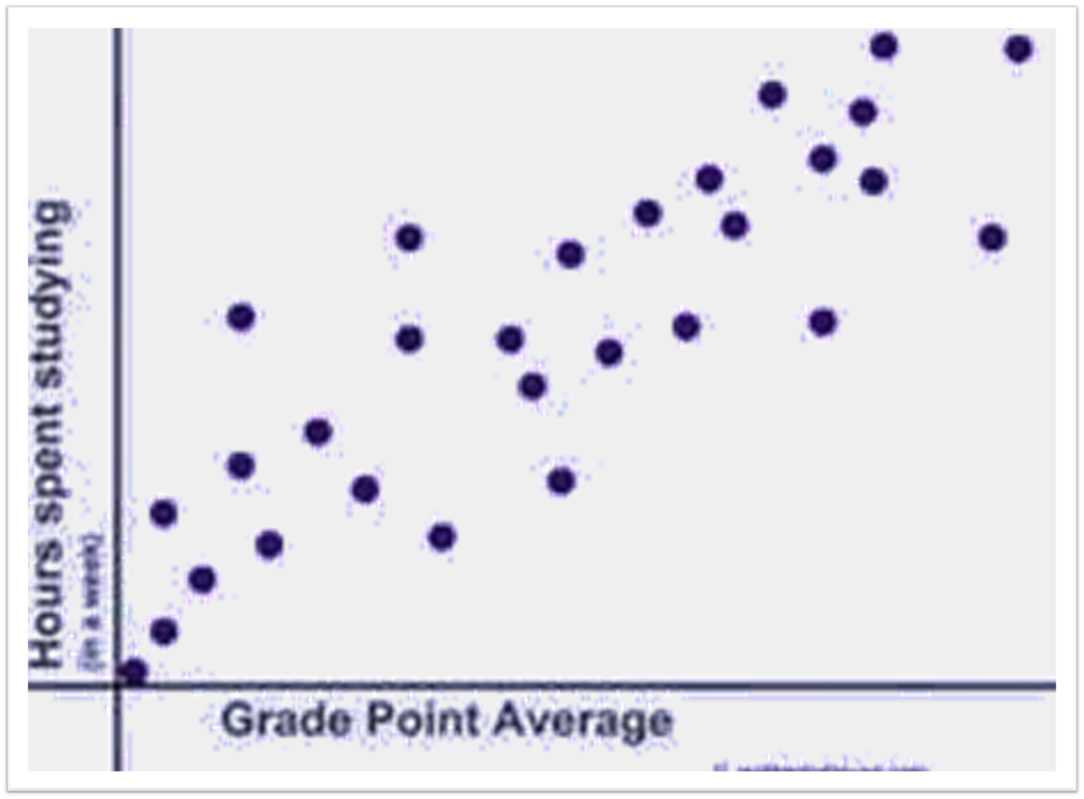
Correlation
P.D.Wimalasiri
[B.Sc. in Maths (Ruhuna), M.Sc.in Computer Science (Col.)]
Lecturer in Computer Science,
Faculty of Management Studies,
Rajarata University of Sri Lanka

Slide 2
Correlation measures the association between two variables.

Slide 3
Examples:
Quantity demand and price of a product.
Sales amount and advertizing cost.
Marks obtained by a student for a subject and the time he spent on studing that subject.
Daily Sales amount of Ice cream and day temperature.

Slide 4
If two variable are plotted in a same graph it can be one of the following cases. These graphs are called Scatter graphs.
All the points are on a straight line.
When one variable increases other one also increases.
y
Positive Perfect correlation. r= +1
Positive Perfect correlation. r=1
x

Slide 5
2. All the points are not on a straight line but most of them are closer to the line .
When one variable increases other one also increases.
y
x
Positive strong correlation.. r1
(r has a value closer to +1)

Slide 6
3. All the points are not on a straight line but most of them are far away from the line .
When one variable increases other one also increases.
y
x
Positive weak correlation.. r0
(r has a value closer to 0)

Slide 7
4. All the points are randomly spreaded.
y
x
No correlation. r=0

Slide 8
5 All the points are not on a straight line but most of them are far away from the line .
When one variable increases other one decreases.
y
x
Negativ eweak correlation.. r0
(r has a value closer to 0)

Slide 9
6. All the points are not on a straight line but most of them are closer to the line .
When one variable increases other one decreases.
y
x
Negative strong correlation.. r -1
(r has a value closer to -1)

Slide 10
7. All the points are on a straight line.
When one variable increases other one decreases.
y
x
Negative Perfect correlation. r= -1

Slide 11
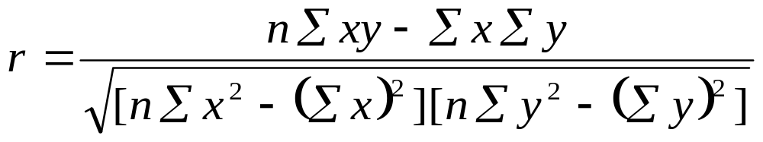
Calculation of coefficient of correlation.
Also known as Karl pearson’s coefficient of correlation.

Slide 12
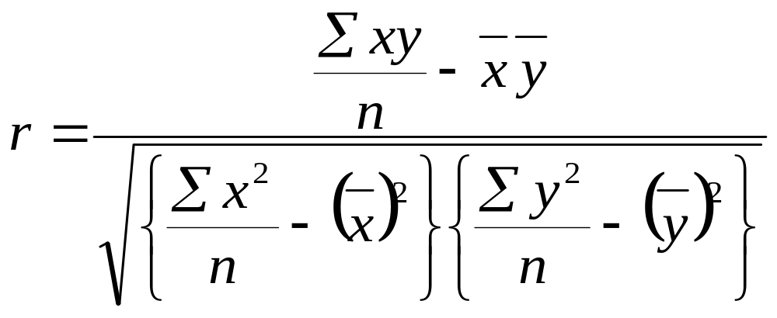
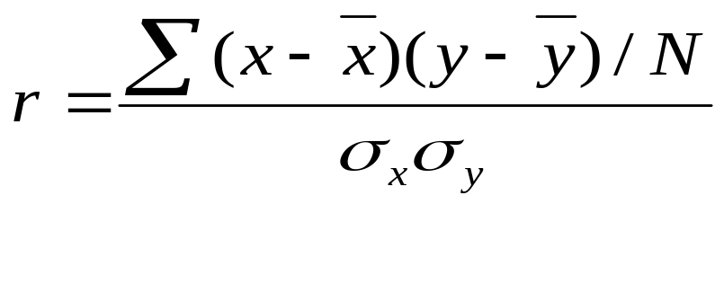
Calculation of coefficient of correlation.…….

Slide 13
Example
x | y
10 | 24
20 | 38
30 | 55
40 | 88
50 | 109
Find the coefficient of correlation between var x and y given as above .

Slide 14
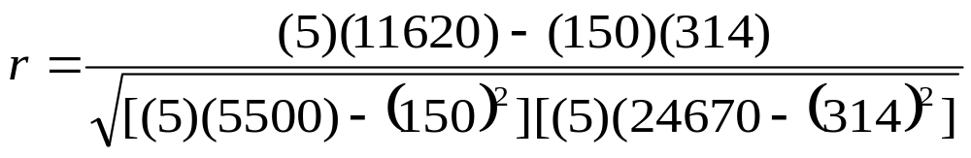
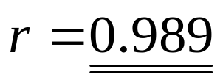
x | y | xy | x² | y²
10 | 24 | 240 | 100 | 576
20 | 38 | 760 | 400 | 1444
30 | 55 | 1650 | 900 | 3025
40 | 88 | 3520 | 1600 | 7744
50 | 109 | 5450 | 2500 | 11881
150 | 314 | 11620 | 5500 | 24670
solution

